Slide 1



Powerful feedback
Notes:
Trainer’s notes
HOW THE NOTES WORK
The notes are meant to help you with the pace and flow of the module.
Remember, it’s an espresso training session. Keep the train running; it can slow down for a bit but never stop.
Notes in “quotation marks” are what you want say to the audience. Feel free to paraphrase.
Notes without quotation marks are for your eyes only. Instructions, background, tips and case studies (which you might use).
Good luck!
DURATION
90 minutes if you keep delegates focused.
ROOM AND SETUP
Ideally use a room with lots of natural light.
Set up the room café style: tables with four participants.
Play music at the start and during breaks. Music encourages people to talk.
Have flipcharts and fresh markers for each table.
STYLE
Fast-paced and practical.
Warmly greet people when they enter the room.
Use a parking lot for tricky questions. Announce it at the start. Chances are you won’t have to use it but it can prevent long diversions.
Mix up participants for each exercise.
TIPS
Be in a good state of mind and well rested.
When you are presenting, distribute your weight equally on your two feet. Don’t slouch.
Never talk for more than ten-minutes without a pause or interaction.
Start at a brisk pace. You can’t make up for lost time later on.
Love your audience:
Know the material so well that you can focus on the participants in the room.
Before you start each section, know what you want participants to learn, feel and do.
Keep to time. If you can’t, don’t blindly stick to your slides. It hurts our hearts(!), but you may have to skip slides if time has slipped away.

Slide 2
Growing Together performance management needs most work
Trend
Bmrk
Mean
-2 | -2 | -3 | -2 | -2 | -2 | -2 | -1 | -2 | -3 | -3 | -2
1 | 1 | n/a | -2 | n/a | -6 | 4 | -7 | n/a | n/a | -2 | -2
4.38 | 4.1 | 4.15 | 3.87 | 4.08 | 3.96 | 3.88 | 4.16 | 4.15 | 4.06 | 3.98 | 4.01
Mean 4.07
Notes:
Trainer’s notes
“Our engagement survey results show that we need to focus on building performance management capability.”

Slide 3
Growing Together growth and dialogue matter
% strongly agree
Mean Score
4.12
4.1
4.08
4.12
4.02
3.99
3.95
Notes:
Trainer’s notes
“Growth and dialogue matter. Giving and asking for feedback is an important part of keeping the dialogue going.”

Slide 4
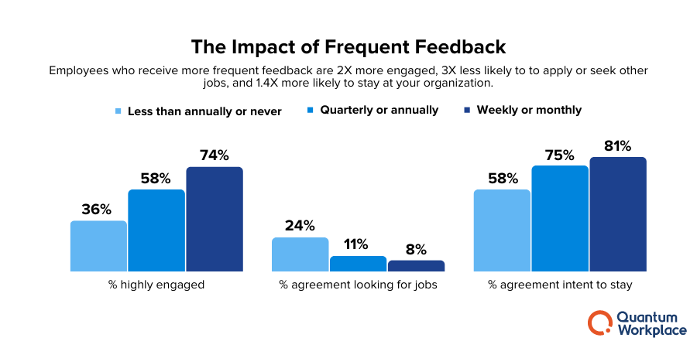

Slide 5
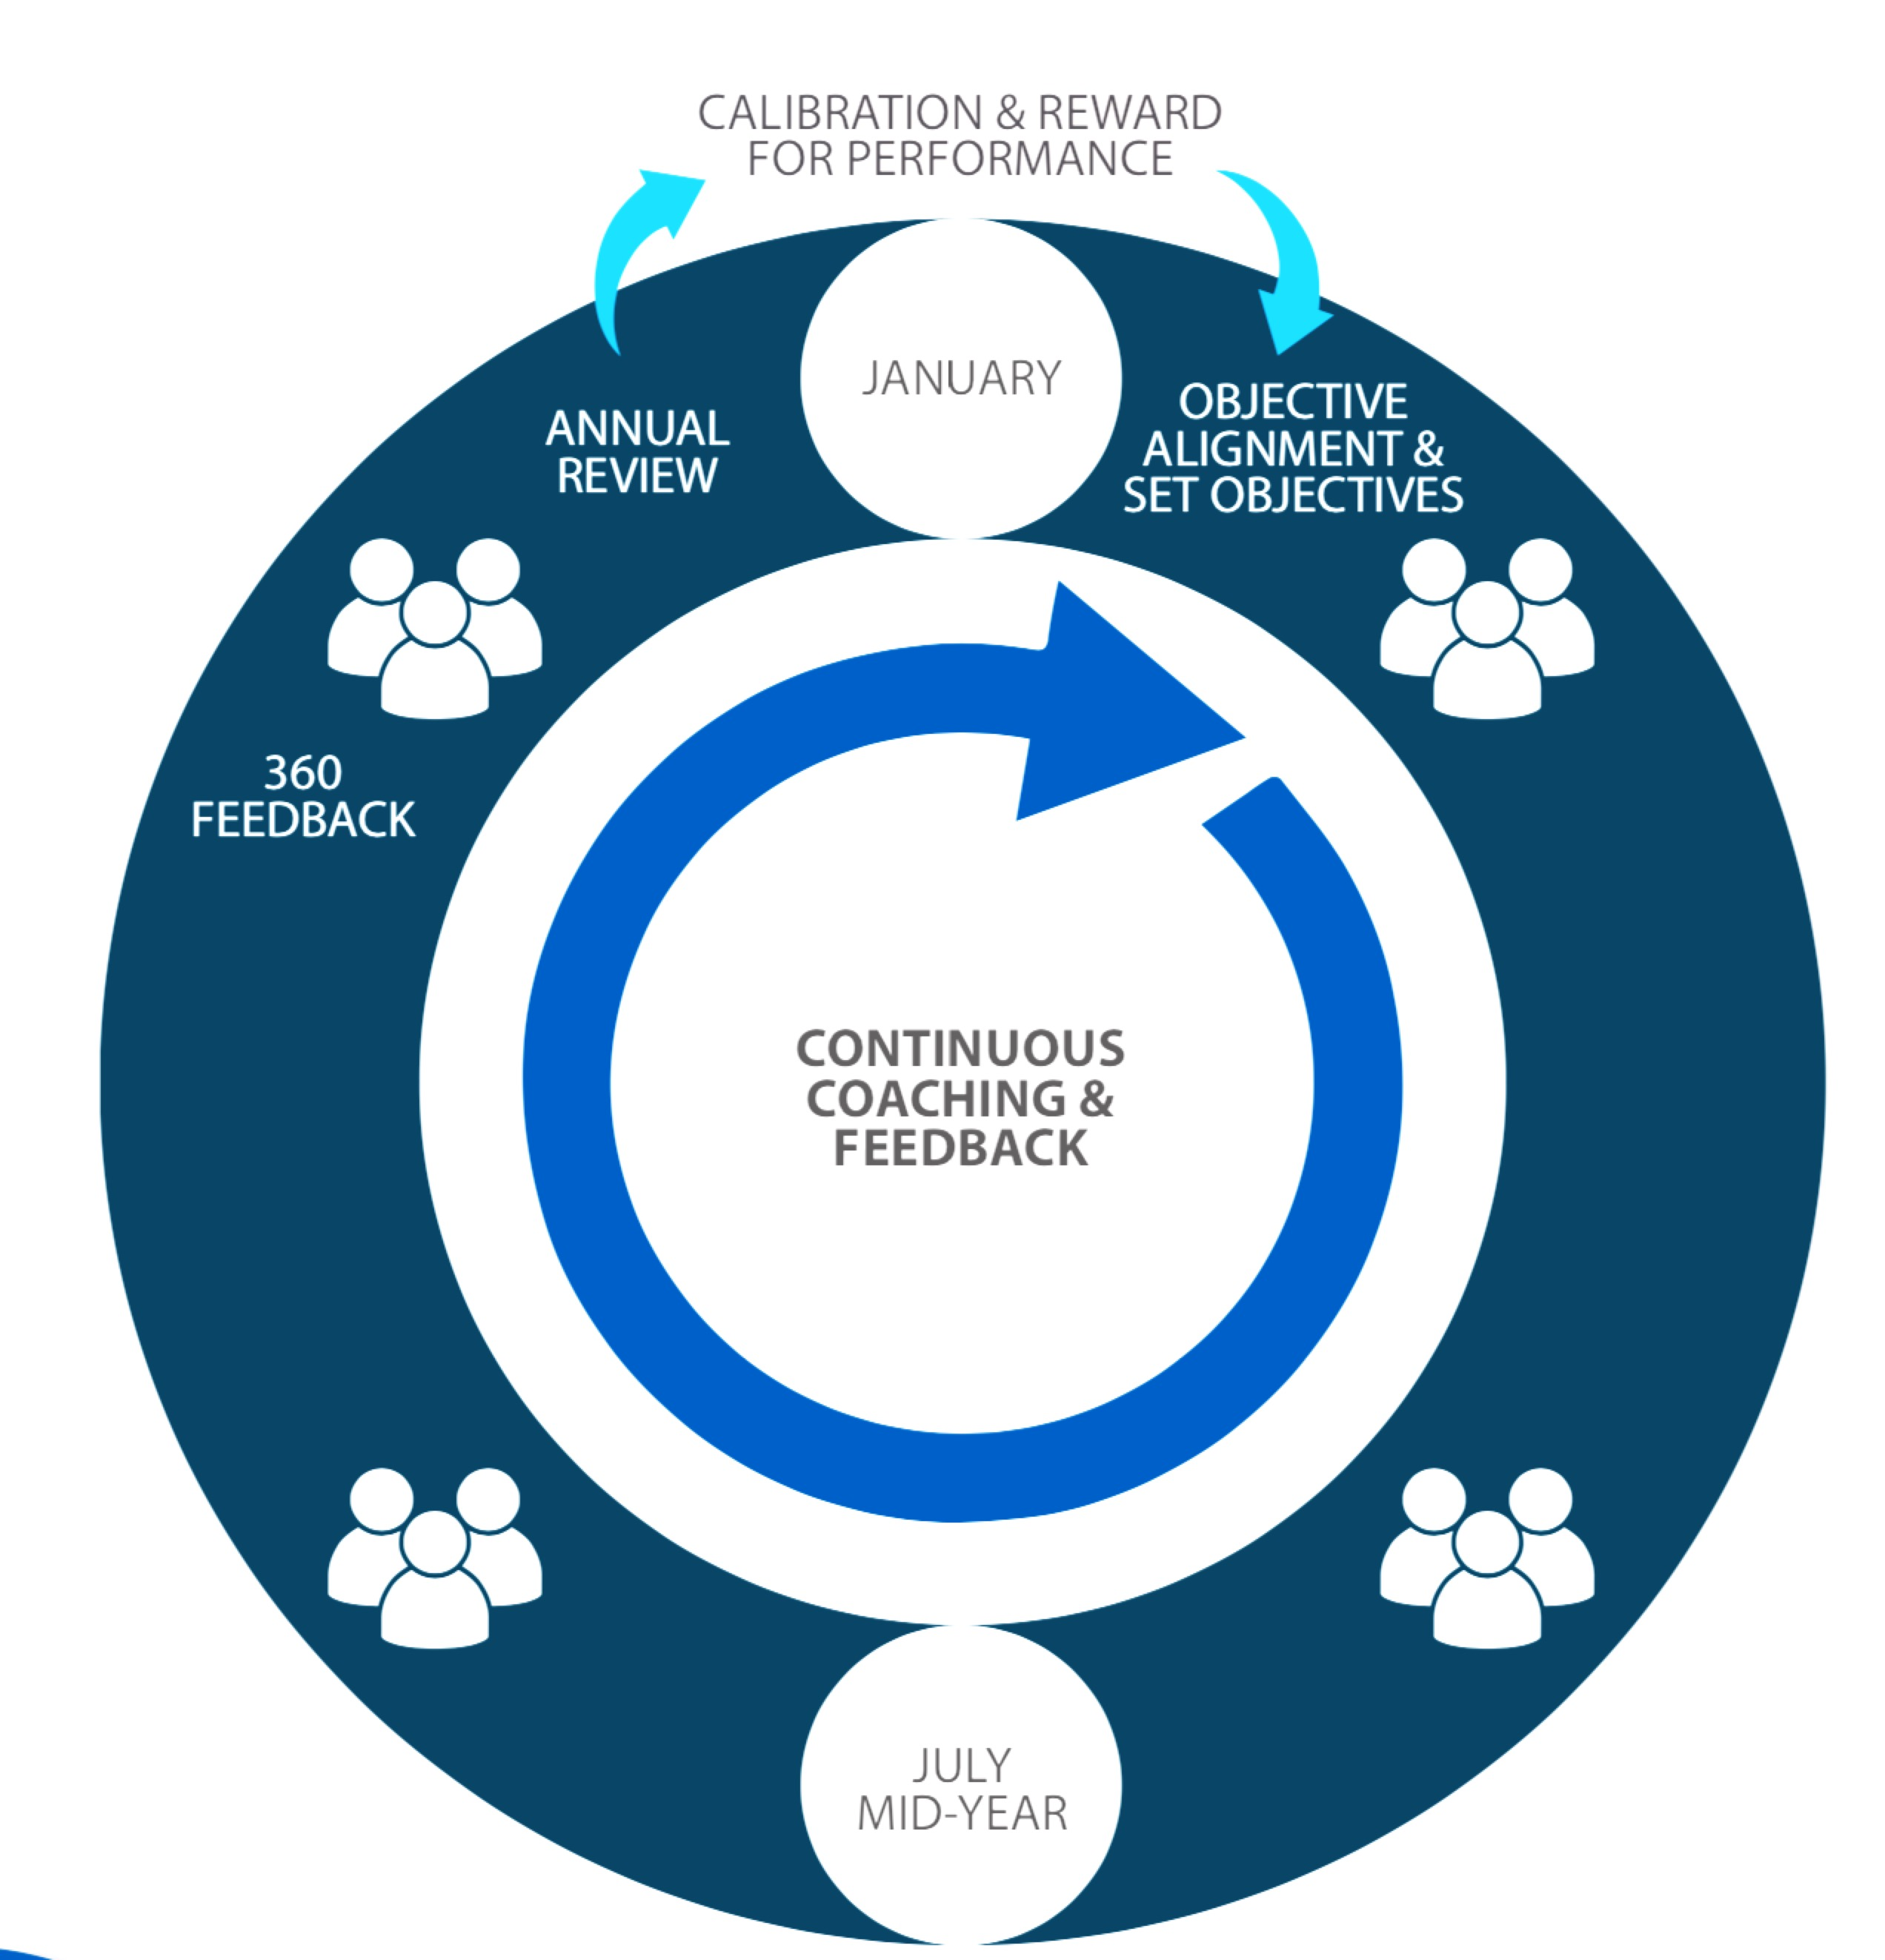
Building just-in-time PM capability
CONFLICT RESOLUTION THAT WORKS
60 min
SETTING GOALS
60 min
10-MINUTE COACHING
60 min
POWERFUL FEEDBACK
60 min
GROWING OUR PEOPLE
60 min
Notes:
Trainer’s notes
“The modules contain all the essential skills you need to support the performance of your people.
Training will be done just-in-time.”

Slide 6




intense
timed
tasters
Notes:
What is the main advantage of drinking espresso instead of americano? It takes less time.
These four sessions are like drinking shots of espresso.
First of all, it’s INTENSE. The content has been condensed from roughly four days into four small chunks to save busy managers’ time. Plus research shows that intense bursts of learning are just as effective as long training sessions.
The trade-off is that we will STRICTLY TIME all activities so that we can deliver the sessions in the short time allotted. Remember we will be learning just as much as if we spent all day discussing these frameworks and research.
The activities are meant to be TASTERS. If you only manage to go through three questions out of eight, that’s absolutely fine. The exercises will give you enough of a taster to get you started. It’s important to apply what you have learned right after the session, and we will support you.

Slide 7

Agenda for today
Giving corrective feedback that works
Asking for feedback
Learning to choose between two feedback models
Giving recognition in ways that resonate
Notes:
Trainer’s notes.
“First, we will focus on how to give corrective feedback.
Then we will explore how to ask for feedback.
Then we will discuss how to give recognition and positive feedback.”

Slide 8



how to give corrective feedback
Copyright © 2017 ALL IN. All rights reserved.
Notes:
Trainer’s notes
“Let’s start with how to give corrective feedback. What’s the difficult thing about giving feedback?
That’s right – people can become very defensive.
First of all, corrective feedback is almost always tough to its recipient. Therefore, use it sparingly and wisely.
However, sometimes there is a glaring or urgent performance issue that must be addressed in a separate conversation.”

Slide 9

think …
about a time when someone gave you corrective feedback
and you didn’t become defensive. Instead, you absorbed
and learnt from the feedback.
What made you respond positively?
Notes:
Trainer’s notes
“Let’s think about effective ways of giving corrective feedback.”
“The first reaction to corrective feedback is often defensiveness. Now, think about a time … (read slide)”
Quickly collect ideas on a flipchart (2 minutes). Reiterate them back to participants and show connection to the following material. For instance, participants may say that they felt safe with the person who gave them feedback. Then you say that creating safety is one of the key elements of giving great feedback.

Slide 10

Notes:
Show the video of Awkward confrontation at work

Slide 11

Notes:
Build a poll on How did the employee feel?
Very unsafe and demotivated
Humiliated
Angry
All of the above

Slide 12






giving corrective feedback
finish
with
coaching
make it
safe
give
feedback
prepare
Notes:
Trainer’s notes
“There are four easy steps I suggest you use when having a difficult conversation. We will go through them one by one.”

Slide 13

1. prepare
What can we prepare?
prepare
Notes:
Trainer’s notes
“First step: get ready for the conversation.
Choose the right time and place. Don’t wait too long. Always do it in private; best – outside of the office.
Choose a time when you are both in the right frame of mind (never angry). One of the best times to do it is mid-morning early in the week (you are not tired yet).
Get input but own your feedback. When you have a very strong view, sense-check your op inion with others. Get input from multiple sources on how someone is doing, but don’t hide behind statements like, “I’ve asked five of your peers and they all say …”
Never, ever, ever use email for giving corrective feedback! People almost always misinterpret corrective written communication – it often comes across sounding WORSE than you intended it.
Write down for yourself what you want to say before the conversation (your brain will feel threatened during the conversation so you might lose your train of thought).”

Slide 14
1. prepare
Choose the right time and place
Own your feedback
Never use email or social media!!!
Write down what you want to say
the specific issue
the impact
what you want to be different
prepare
Notes:
Trainer’s notes
“First step: get ready for the conversation.
Choose the right time and place. Don’t wait too long. Always do it in private; best – outside of the office.
Choose a time when you are both in the right frame of mind (never angry). One of the best times to do it is mid-morning early in the week (you are not tired yet).
Get input but own your feedback. When you have a very strong view, sense-check your opinion with others. Get input from multiple sources on how someone is doing, but don’t hide behind statements like, “I’ve asked five of your peers and they all say …”
Never, ever, ever use email for giving corrective feedback! People almost always misinterpret corrective written communication – it often comes across sounding WORSE than you intended it.
Write down for yourself what you want to say before the conversation (your brain will feel threatened during the conversation so you might loose your train of thought).”

Slide 15
giving corrective feedback
part I
Think about a person in your life to whom you would like to give corrective feedback.
Write down the issue, the impact and what you want the person to do differently. Be concise (3 minutes).
Notes:
Trainer’s notes
“When we created this programme, we decided to not use abstract role-plays, but to make it as close to real life as possible.
Therefore today we will ask each of you to think about real-life scenarios and then practice this model using those scenarios.”
This is an individual assignment – do not discuss in groups. However, let the participants know that they will need to share this in the later part of the exercise.

Slide 16
2. make it safe
make it
safe
prepare
Notes:
Trainer’s notes
“The next step is to ensure that you make the person feel safe.”

Slide 17



“Respect is like air.
If you take it away it’s all people
can think about.”
Patterson, et al, Crucial Conversations.
Notes:
Trainer’s notes
“Here is a nice quote from Patterson.”

Slide 18

remember why ‘telling’ doesn’t work very well?
prefrontal cortex
Notes:
Trainer’s notes
“Remember, in the 10-minute coaching module we discuss why constantly telling people what to do does not work.
It has to do with how our brain works. Prefrontal cortex is a very important part of the brain that is responsible for making decisions, and yet is very energy-hungry, weak, and capricious.
It is very easy to upset it – if you expose your brain to any physical threat, the fight-or-flight system of the brain (so-called limbic system) is activated. Brain resources flow in to support it, and as a result prefrontal cortex cannot function well, so we literally become dumb.
So here’s the key point: it seems that our brain cannot differentiate between a PHYSICAL threat and SOCIAL threat.
When we tell people what they should do, they feel defensive. When people feel defensive, they don’t think straight. Corrective feedback could make people feel very defensive.”

Slide 19
loosen the SCARF before giving feedback
Status
am I more, less or as important as you are?
Certainty
do I know what will happen to me?
Autonomy
do I have a say or not?
Relatedness
are you my friend or foe?
Fairness
will you be fair to me?
Source: aadapted from “Your Brain at Work”, David Rock, Harper Business, 2009
Notes:
Trainer’s notes
”In the last module we also covered the SCARF framework. Think about SCARF. What does it stand for? These are the aspects of social experience our brain treats as survival issues. If any of these is under threat, our brain goes into a fight-or-flight mode, can’t think straight, can’t take ideas on board, and can’t make good decisions.
Remember, in the majority of cases the person will KNOW you are about to give them corrective feedback. Their SCARF will be already VERY TIGHT.”
You may demonstrate it with a real scarf, or just talk through the slide.
”What happens if you PULL IT EVEN TIGHTER? They suffocate. But you can also LOOSEN IT A BIT.”
“How do you loosen it? (create safety).”
Trainer: ask the participants and collect ideas on how to create safety on the flipchart. (2 minutes).

Slide 20
2. make it safe
make it
safe
invite self-reflection
autonomy, status
prepare
Notes:
Trainer’s notes:
“Another way to loosen their SCARF is to give them a chance to give themselves feedback first. For example: I’d like you to think about how things have been going with [situation X] and give yourself some feedback. What do you think worked and what could you have done better?”

Slide 21
2. make it safe
make it
safe
reassure them
Relatedness, Certainty
prepare
Notes:
Trainer’s notes
“First, you reassure them – it builds Relatedness and Certainty (from SCARF).”
”For example, you might say: Thank you for taking the time to talk. We have plenty of time and we won’t be interrupted, so there’s no need to rush this discussion. Before we get started I want you to know that I value your contribution to this team. I’d like to see how I can help you be the best you can be in your role. We will work together to find a solution.”

Slide 22
think …
about a time when someone gave you corrective feedback
and you didn’t become defensive. Instead, you absorbed
and learnt from the feedback.
What made you respond positively?
Notes:
Trainer’s notes
“Let’s think about effective ways of giving corrective feedback.”
“The first reaction to corrective feedback is often defensiveness. Now, think about a time … (read slide)”
Quickly collect ideas on a flipchart (2 minutes). Reiterate them back to participants and show connection to the following material. For instance, participants may say that they felt safe with the person who gave them feedback. Then you say that creating safety is one of the key elements of giving great feedback.

Slide 23
giving corrective feedback
part II
Now, write down how you will set up this conversation in a way that will make the person feel safe (2 minutes).
Notes:
Trainer’s notes:
This exercise builds on the previous one. Ask the participants to work on it individually (no discussion at this point).

Slide 24
giving corrective feedback
finish
with
coaching
make it
safe
give
feedback
prepare
Notes:
Trainer’s notes
“There are four easy steps I suggest you use when having a difficult conversation. We will go through them one by one.”

Slide 25
3. give feedback
ask permission
focus on one issue
describe specific behaviours and the impact
make it
safe
give
feedback
get
ready
Notes:
Trainer’s notes:
Ask permission to give feedback: I would like to give you some feedback. Would that be OK with you?” (increasing Autonomy and Status).
Keep it focused. Choose one behavior to focus on. Don’t ramble or recite long lists of things to address, or your feedback will wash over the person and they won’t act on it.
Be very specific. Describe the behavior (the what and the how) and the impact on the team, business, customers, you. Stick to the facts. Do not deviate into making character judgments such as ‘you always’, ‘you never’ etc.“

Slide 26
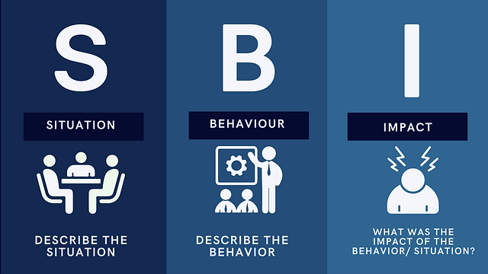
SBI Feedback Model – For delivering feedback on an incident/situation
Notes:
Give Feedback with Situation-Behavior-Impact (SBI) (youtube.com)

Slide 27
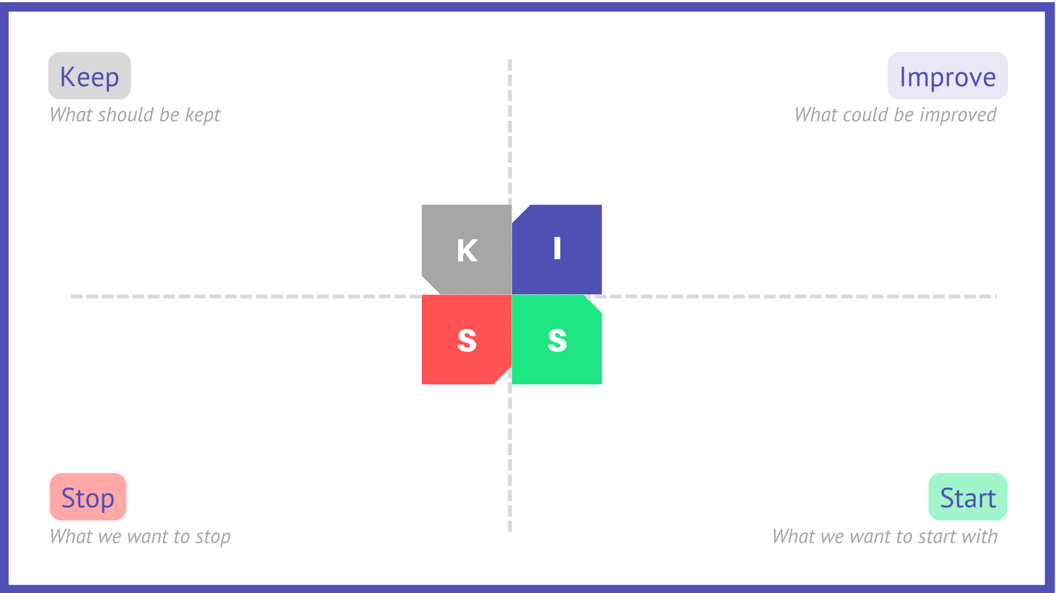
KISS Feedback Model – For Mid year & Year end conversations
Notes:
To make sure the group gets the most out of the technique, explain the acronym in advance:
Keep: things we want to keep doing
Improve: things we want to improve
Stop: things we want to stop doing
Start: things we want to start doing

Slide 28
examples
Instead of “You are too dominating,” say “At the last meeting, you interrupted Ahmed and Mary several times. It made it difficult for them to share their ideas.”
Instead of “What you did at that meeting was awful,” say “When the customer asked you questions you gave her really short answers and once you turned your back to her. She shut down for the rest of the meeting and seemed upset.”
Notes:
Trainer’s notes:
“Let’s walk through a couple of examples of before and after.”

Slide 29


feedback
coaching
29
past behaviour
future
behaviour
evaluate & correct
develop
tell
ask & help
find own way
Notes:
Trainer’s notes
“Remember, we discussed the difference in the previous module? People are often confused about the definition of coaching and how it differs from feedback. While there may be some overlap, these are two very distinct methods of interaction. There is a difference in FOCUS, PURPOSE, and MEANS.
The FOCUS of feedback is on past behaviour. The FOCUS of coaching is on future behaviour.
The PURPOSE of feedback is to evaluate and correct. The PURPOSE of coaching is to develop.
The MEANS of feedback is by telling. The MEANS of coaching is by asking and helping a person to find their own way.
Both tools are important, and every leader needs to have both in their toolkit.”

Slide 30
even if you must start with corrective feedback,
finish with coaching
Notes:
Trainer’s notes
“Since coaching is so much easier on the recipient, our main proposition for you today is that you can indeed COMBINE the two – start with feedback, finish with coaching. We will show you how to do in a minute.”

Slide 31
4. finish with coaching
finish with coaching
check their reaction – are we on the same page?
focus on the future – ask solution-oriented questions
listen and let them do most of the thinking and talking
keep asking permission
clarify your agreement on the way forward
affirm the relationship
make it
safe
give
feedback
get
ready
Notes:
Trainer’s notes
“The final step of this framework: once you have given feedback, switch into a coaching mode and help the other person find their own way of fixing their behaviour.
First, check their reaction – whether the person accepts it, check for understanding: How do you feel about that?
Then focus on the future by asking solution-focused questions: How can we make sure you do it differently next time…
Keep asking permission – it loosens the SCARF and allows the person to find better solutions. You can use questions such as:
Can I ask you a few questions to help you solve it?
Would you allow me to make some observations?
Is it ok with you if we focus on this right now?
Would you be willing to do this?” (Instead of “I want you to do this.”)
Can I tell you what I would like you to do differently?
Summarise at the end: Let me summarise what we decided to do going forward …
Affirm the relationship: Thank you for this discussion. I know it was not easy for you. I want you to know that I really value your contribution to our team/business. I am confident that together we will solve this.”

Slide 32
Recall the 4 steps
Notes:
Trainer’s notes
Remind participants of the four simple steps.

Slide 33
giving corrective feedback
finish
with
coaching
make it
safe
give
feedback
prepare
Notes:
Trainer’s notes
“There are four easy steps I suggest you use when having a difficult conversation. We will go through them one by one.”

Slide 34
giving corrective feedback
part III
Prepare
think about a person in your life who needs corrective feedback
describe the situation to another participant
give them enough context to role play that person
Have a conversation. Ensure that you:
establish safety
describe specific behaviours, impact and what you want to change
coach them to develop their own solutions
affirm the relationship
Notes:
Trainer’s notes
“This is a final exercise for corrective feedback that builds on the previous two parts.
You need to split into pairs.
If you want to preserve confidentiality, use A FAKE NAME.”
Trainer: debrief the exercise at the end. How did it go?

Slide 35

how to ask for feedback
Notes:
Trainer’s notes
“We’ve discussed how to give feedback so far. Now, let’s turn to how we ask for feedback.”

Slide 36
why people avoid giving honest feedback to their boss
Notes:
Trainer’s notes
Remind participants of the four simple steps.

Slide 37
why people avoid giving honest feedback to their boss
they see their boss as unapproachable or insecure
they fear the boss will get defensive, blame the messenger and fail to address the problem
they worry about being perceived as negative and non-collaborative
they fear the boss might harm their career
they don’t see the point – nothing will happen anyway
Notes:
Trainer’s notes
“When asking for feedback as leaders, we run into a serious obstacle: most people do not like giving direct, and especially corrective feedback to their bosses. Why do you think that is?
Here is what research tells us (list the five bullets). The most frequently cited obstacle is the last one.”

Slide 38
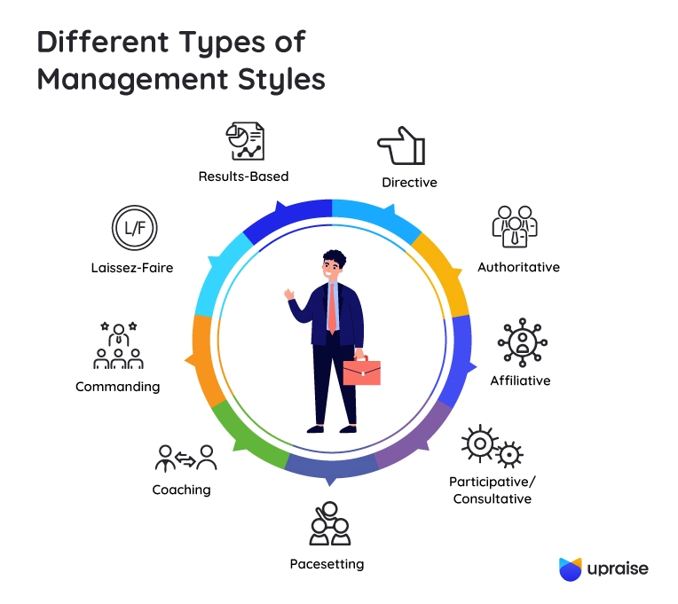

Slide 39
telling your people that you have an open-door policy is not enough
how do you create conditions where your people feel truly safe to give you honest feedback?
Notes:
Trainer’s notes
Read the slide.
“So, where do we begin? Let me ask you a question: what happens to MY OWN SCARF when I solicit feedback?” (Answer: it tightens. We may feel uncomfortable.)
“How will the other person react when they see my tightening my own SCARF?” (Answer: they feel we are uncomfortable and in turn, it makes them feel unsafe either. Therefore most people just end up telling you what they think you want to hear!)

Slide 40
1. prepare
Think of a specific behaviour or a project
Ask yourself: “Why do I really want to get this feedback?”
prepare
Notes:
Trainer’s notes
“The good thing is that for asking for feedback we don’t need another framework. We could simply use the same framework as above, just flip a couple of elements!
Start with some quick preparation. Think about a specific behaviour or a project you’d like to get feedback on.
Next, ask yourself: why do I want to get this feedback? If you simply expect people to tell you that you did great, don’t bother asking! Only ask for feedback if you genuinely want to improve and are ready to take both positive and corrective feedback.

Slide 41
When you ask for feedback from your team,
how tight does your SCARF feel?
Status
Certainty
Autonomy
Relatedness
Fairness
Source: aadapted from “Your Brain at Work”, David Rock, Harper Business, 2009
Notes:
Trainer’s notes
”In the last module we also covered the SCARF framework. Think about SCARF. What does it stand for? These are the aspects of social experience our brain treats as survival issues. If any of these is under threat, our brain goes into a fight-or-flight mode, can’t think straight, can’t take ideas on board, and can’t make good decisions.
Remember, in the majority of cases the person will KNOW you are about to give them corrective feedback. Their SCARF will be already VERY TIGHT.”
You may demonstrate it with a real scarf, or just talk through the slide.
”What happens if you PULL IT EVEN TIGHTER? They suffocate. But you can also LOOSEN IT A BIT.”
“How do you loosen it? (create safety).”
Trainer: ask the participants and collect ideas on how to create safety on the flipchart. (2 minutes).

Slide 42
2. make it safe
reassure yourself first
Make sure you are in a good emotional shape to take feedback.
…then reassure the other person
make it
safe
prepare
Notes:
Trainer’s notes
Make it safe – FIRST FOR YOURSELF, and then for the person you are asking feedback from. If you feel insecure, tell yourself: This is not about my value as a person. I want to know how I can become better at X, so I’m choosing to ask for feedback.
Then reassure the other person: I want to be better at X. Can I ask you for some honest feedback? It will be extremely helpful for me. I am not expecting that you’ll give me only positive feedback – tell me what worked and what I could have done better.”

Slide 43

3. receive feedback
invite
coaching
DON’T
explain, interrupt or act defensively
Listen actively and use mirroring
ask clarifying questions
make it
safe
receive
feedback
get
ready
Notes:
Trainer’s notes
“Now, instead of giving, simply receive feedback. Be specific. Ask about your behavior (the what and the how), and what impact it had on them (or team, business, customers, etc). The most important thing when receiving feedback is to stop yourself from interrupting or making defensive comments (remember: YOU asked for honest feedback! Even if you disagree with it, your job now is to listen).
Listen actively, use mirroring body language, and sometimes ask clarifying questions – for example: Could you tell me more please? Could you elaborate on X? Make sure your questions are not veiled attacks or self-justification.”

Slide 44
4. invite coaching
invite
coaching
What can I do differently next time?
What can I do to help you?
What else can I do?
THANK THEM!
make it
safe
give
feedback
get
ready
Notes:
Trainer’s notes
“Finally, once you have received feedback, switch into a coaching mode and help the other person coach you to improve your behaviour. Do it by asking future-oriented questions: How would you like me to handle it better? What can I do differently next time? What else can I do?
Do not forget to thank them, even if you disagreed with some aspects of their feedback. Remember, they have given you a gift!
Never retaliate! If you do, they will never give you honest feedback again. If you feel unsure you can handle corrective feedback, it’s better not to ask for it than ask for it and take it badly.”

Slide 45
how to ask for feedback
invite coaching
make it
safe
receive
feedback
prepare
Notes:
Trainer’s notes
“As you may have noticed, the process of receiving feedback is virtually identical to the one of giving feedback, with a couple of variations. You still prepare. Then you make it safe FOR BOTH PARTIES. Then you receive (instead of giving) feedback. And finally, you still finish by asking coaching questions.”

Slide 46
ask for feedback
Prepare (1 minute)
find someone in the room who knows you
think about a specific situation that both of you are aware of, about which you would like some feedback
if you don’t know anyone, role-play
Ask for and receive feedback (5 minutes). Ensure you:
establish safety for yourself and for the other person
probe and ask clarifying questions
do not offer explanations – just listen and ask questions
Notes:
Trainer’s notes
“Here is another exercise for you” (read the slide).
If delegates don’t know someone in the room, ask them to think of a situation they would like feedback on and quickly brief the other person.

Slide 47

how to give recognition
Notes:
Trainer’s notes
“Now, let’s switch our attention to how to give positive feedback – or in other words, recognition.
First, we will look at some of the principles, and then will practice.”

Slide 48

In the 90s, psychologist John Gottman could predict from observing couples, whether they will stay together or fall apart in the next 10 years to nearly 100% accuracy.
All he did was watch a video recording of them having a 10-minute conversation in his waiting room.
Notes:
Trainer’s notes
“Here is a fun study for you. In the 90s psychologist John Gottman could predict from observing couples, whether they will stay together or fall apart in the next 10 years to nearly 100% accuracy. All he did was watching a video recording of them having a 10-minute conversation in his waiting room. What do you think he was looking for?
He was counting the ratio of positive to negative interactions that people had while no one was watching (those could be body language, tone of voice, content or how they were saying it). Gottman found that if the couple had a ratio of 5:1 of positive to negative interactions, or higher, they would almost certainly stay together. However, if the ratio fell below 0.77:1, he said their relationship would almost certainly end.
There is something very important this study tells us about the power of positive vs negative interactions. Negative interactions have a disproportionately higher impact that the positive ones!”

Slide 49
the magic ratio
5:1
stay together
0.77:1
fall apart
Source: Gottman, J. What Predicts Divorce. 1994.
Notes:
Trainer’s notes
“Here is a fun study for you. In the 90s psychologist John Gottman could predict from observing couples, whether they will stay together or fall apart in the next 10 years to nearly 100% accuracy. All he did was watching a video recording of them having a 10-minute conversation in his waiting room. What do you think he was looking for?
He was counting the ratio of positive to negative interactions that people had while no one was watching (those could be body language, tone of voice, content or how they were saying it). Gottman found that if the couple had a ratio of 5:1 of positive to negative interactions, or higher, they would almost certainly stay together. However, if the ratio fell below 0.77:1, he said their relationship would almost certainly end.
There is something very important this study tells us about the power of positive vs negative interactions. Negative interactions have a disproportionately higher impact that the positive ones!”

Slide 50

the magic ratio … in the workplace
5.6:1
high-performing
0.36:1
low-performing
Source:. Losada and Heaphy. The role of positivity and connectivity in the performance of business teams. 2004
Notes:
Trainer’s notes
“You might say that what works in personal relationships, doesn’t work in the workplace. However, 10 years later another scholar Marcial Losada run a similar study in the work environment.
He found that high-performance teams had a ratio of positive to negative interactions of 5.6:1, and low-performance teams - a ratio 0.36:1.
The most important application of these studies is that people need much more positive than corrective/negative feedback in their interactions with others. If you err on the side of positivity, you will create an environment, where giving corrective feedback will be much easier because of the underlying strength of the relationship.”

Slide 51

Notes:
Let me share with you 4 steps for this…

Slide 52
make the effort – take an interest in people
learn what makes them feel special
be
curious
Copyright © 2017 ALL IN. All rights reserved.
Notes:
Trainer’s notes
“However, giving a GOOD QUALITY recognition may be surprisingly difficult. There are four principles of giving great recognition:
First of all, be Curious about your people. Take real interest in them, learn what makes that particular person ‘tick”. For example, some people love public recognition, others absolutely hate it!”

Slide 53
be
generous
Notes:
Trainer’s notes
“Secondly, be generous with positive feedback – do it often. Remember the 5:1 ratio! One major study shows that people need recognition for good work at least once a week.”

Slide 54
be timely
Notes:
Trainer’s notes
“Third, be quick with recognition – give it as close to the even as possible. Recognition loses power over time. That’s why traditional recognition programmes don’t work very well – they might happen months after an employee did something great.”

Slide 55
What exactly was great about it?
What difference did it make to you (or the customer, team or project)?
What effort did they make?
What challenges did they overcome?
be specific
Notes:
Trainer’s notes
“Finally, and MOST IMPORTANTLY, be as specific as possible. Saying ‘great work’ is nice, but it lacks the punch of saying Your positive attitude to the client and attention to detail in providing that service was outstanding.
Describe the behaviour & the impact it had. There are some useful questions on this slide you might want to ask yourself before you give recognition.”
Trainer: give an example of great recognition you’ve received and explain why it was so meaningful to you.

Slide 56
curious
generous
timely
specific
Notes:
Trainer’s notes
Remind participants of the four aspects of great feedback.

Slide 57

giving recognition
Your choice.

Slide 58

Recognition is most effective when it comes from all directions: make it a BASIC EXPECTATION in your team
Notes:
Trainer’s notes
Read the slide.
“Recognition doesn’t have to come from you as a leader only. Try to create a culture of recognition in your team.”

Slide 59
create a culture of recognition
Role-model giving regular recognition: observe keenly and catch your people doing the right thing.
Practice the magic 5:1 ratio; it makes giving corrective feedback much easier.
Use every touch point – coffee breaks, catch-ups, email, regular team meetings etc.
Notes:
Trainer’s notes
”How do we create a culture of recognition? Here are some suggestions (read the slide).”

Slide 60

summary & next steps
Notes:
Trainer’s notes
“Let’s summarise what we’ve covered today.”

Slide 61
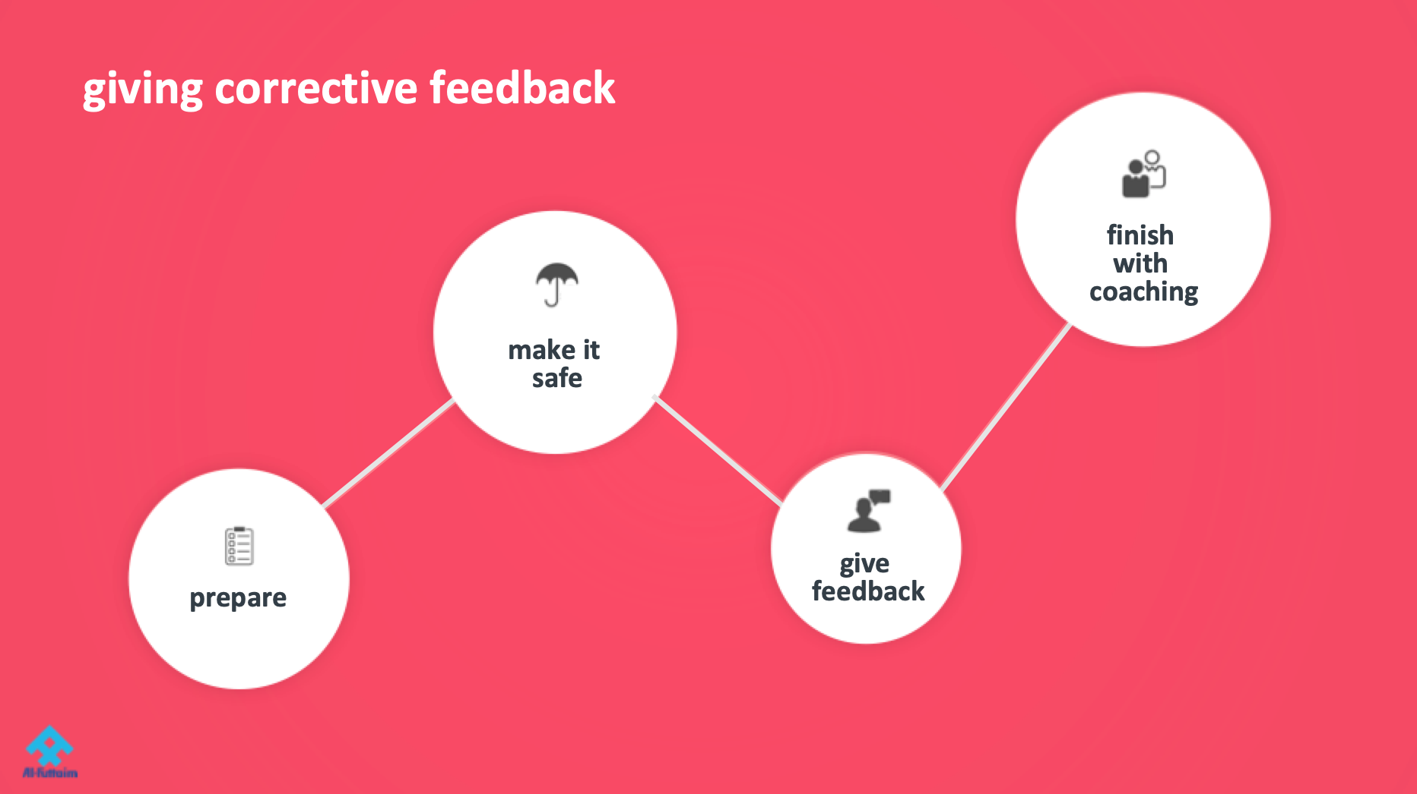
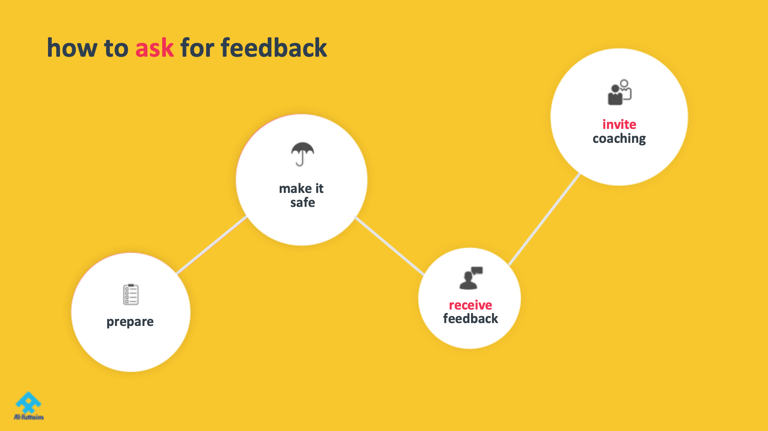


summary of the module
Notes:
Trainer’s notes
Read the headlines of the four slides.
“Now, let me reiterate the most important thing we’ve learn today.
Giving corrective feedback is important and we’ve learned a safer way of doing it.
However, remember that giving positive feedback/recognition must be much more FREQUENT.
If we build a culture of regular positive feedback, then giving critical feedback will be much easier.
If you use 5:1 ratio of positive to negative comments, then you have “money in the bank” – it gives you psychological permission to say something of a corrective nature.
Remember SCARF: what does it feel like to interact with someone who always notices what’s good about you, is clear with his expectations of you, lets you make decisions, connects on a personal level, and treats you fairly? You feel calmer, happier, more confident, more connected and smart. Your brain can process richer streams of information – the world gets bigger. Then you are much more likely to hear that person when they give you corrective feedback.”

Slide 62
one-page summary and next steps
Notes:
Trainer’s notes
“As before, you will get access to a short summary of the module.”

Slide 63
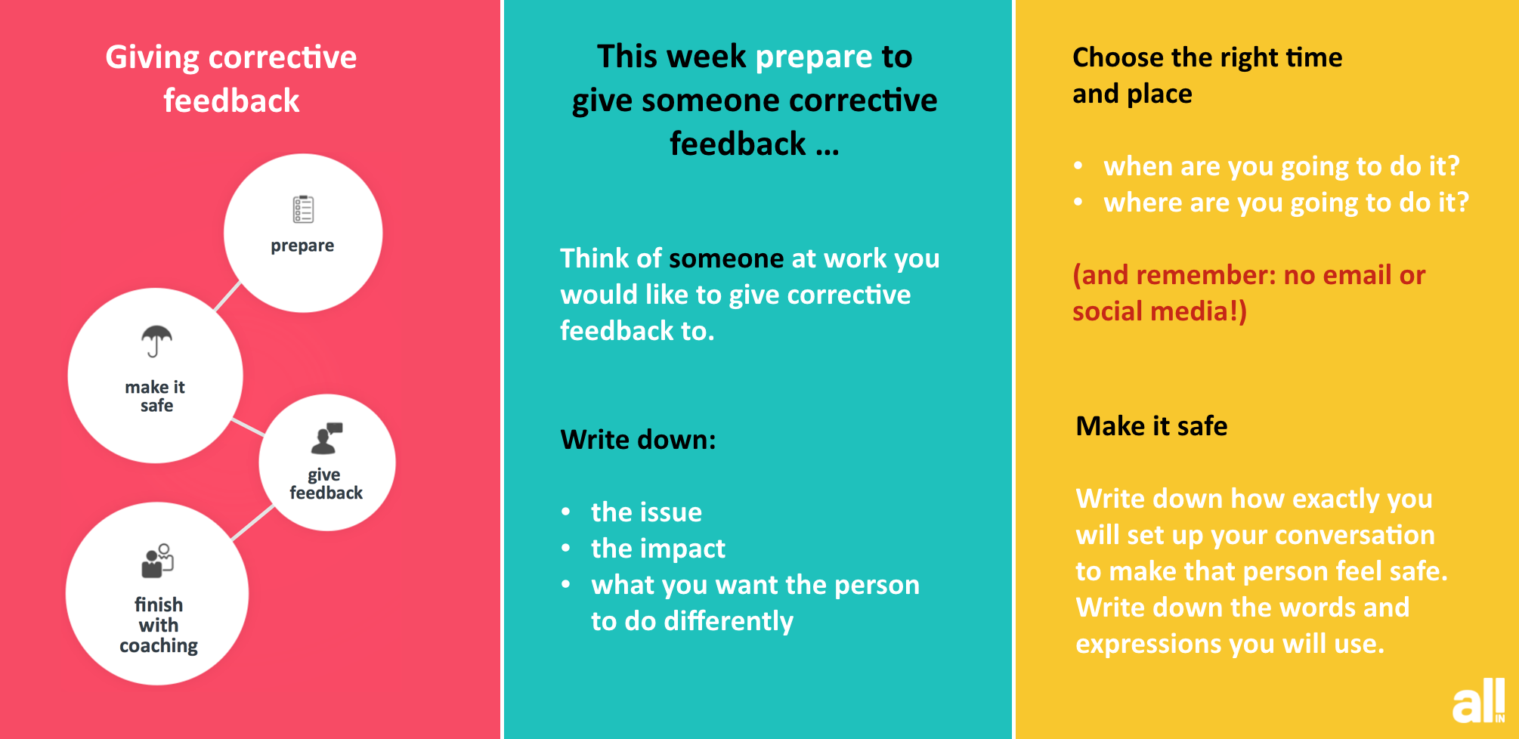
weekly nudges
Notes:
Trainer’s notes
“You will also receive eight weekly nudges via email reminding you to think about what we’ve covered today.”
“Why do you think we send eight weekly nudges?”
“Because, on average, it takes 66 days for people to form new habits.”

Slide 64
closing comments
Notes:
Trainer’s notes
“Now I’d like you to take a moment to think: Where is your head at now?”
“Then let’s go around the room and share your closing comments. About 15 seconds each please.”

